Slide 1

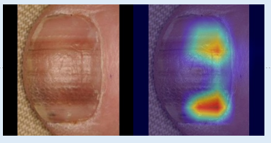
Nail Melanoma Project
Capturing misclassified samples and Explainability
Supervisor: Juan Prada
Second Examiner: Thomas Dandekar
Ayca Öztürk, 2777497

Slide 2
Vision Transformer Fine-Tuning Results (Multi Class)
 | epochs | batch size | learning rate | accuracy | F1-Score (healthy) | F1-Score (melanoma) | F1-Score (other)
1 (initial values) | 10 | 32 | 1e-3 | 0,97 | 0,98 | 0,95 | 0,97
2 | 20 | 32 | 1e-3 | 0,98 | 0,98 | 0,97 | 0,98
3 | 50 | 32 | 1e-3 | 0,98 | 0,98 | 0,97 | 0,98
4 | 10 | 16 | 1e-3 | 0,98 | 0,98 | 0,97 | 0,98
5 | 20 | 16 | 1e-3 | 0,98 | 0,98 | 0,96 | 0,98
6 | 50 | 16 | 1e-3 | 0,98 | 0,98 | 0,97 | 0,98
7 | 10 | 16 | 3e-4 | 0,98 | 0,98 | 0,97 | 0,98
8 | 20 | 16 | 3e-4 | 0,97 | 0,98 | 0,95 | 0,97
9 | 50 | 16 | 3e-4 | 0,98 | 0,98 | 0,97 | 0,98

Slide 3
YOLO Fine Tuning Results (Multi Class)
 | epochs | batch size | learning rate | accuracy | F1-Score (healthy) | F1-Score (melanoma) | F1-Score (other)
1 (initial values) | 20 | 32 | 1e-3 | 0,982 | 0,98 | 0,96 | 0,98
2 | 10 | 32 | 1e-3 | 0,986 | 0,99 | 0,96 | 0,98
3 | 50 | 32 | 1e-3 | 0,985 | 0,98 | 0,97 | 0,98
4 | 10 | 16 | 1e-3 | 0,976 | 0,98 | 0,94 | 0,97
5 | 20 | 16 | 1e-3 | 0,985 | 0,99 | 0,96 | 0,98
6 | 50 | 16 | 1e-3 | 0,978 | 0,98 | 0,96 | 0,97
7 | 10 | 32 | 3e-4 | 0,986 | 0,99 | 0,96 | 0,98
8 | 20 | 32 | 3e-4 | 0,982 | 0,98 | 0,96 | 0,98
9 | 50 | 32 | 3e-4 | 0,985 | 0,98 | 0,97 | 0,98

Slide 4
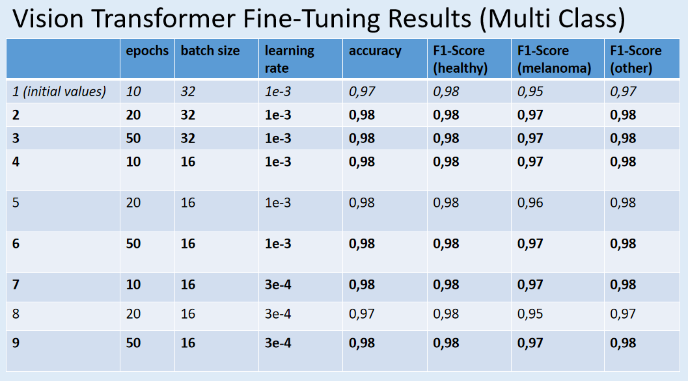
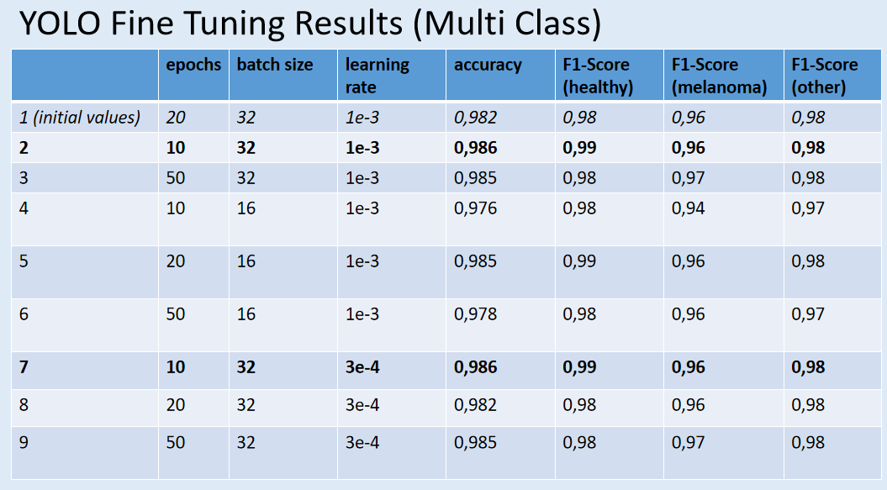
ViT vs YOLO
highly stable results, with overall accuracy consistently around 0.98.
strong generalization and minimal sensitivity to hyperparameter changes
Although YOLO is primarily an object detection architecture, it also achieved strong classification results when fine-tuned in a multi-class setting.
Both models reach excellent performance overall, with extremely high classification accuracy across all three classes.

Slide 5
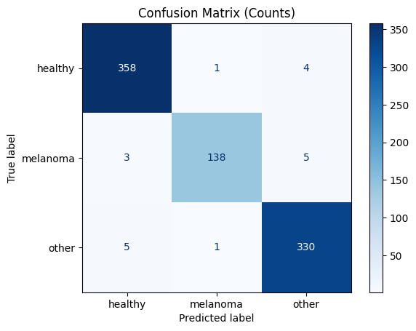
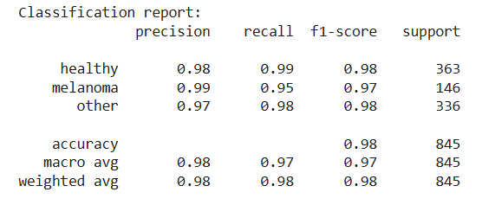
Misclassified samples from Vision Transformer
epochs: 20, batch size: 32, lr0: 1e-3 (one of the best performing configurations)

Slide 6
ViT
True Class | Predicted: healthy | Predicted: melanoma | Predicted: other | total
Healthy | 358 (correct) | 1 (false) | 4 (false) | 363
Melanoma | 3 (false) | 138 (correct) | 5 (false) | 146
Other | 5 (false) | 1 (false) | 330 (correct) | 336
Healthy: 358/363
Melanoma: 138/146
Other: 330/336
Total errors: 19

Slide 7
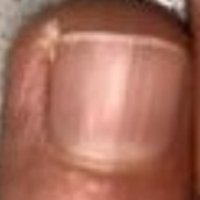
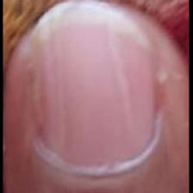
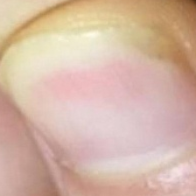
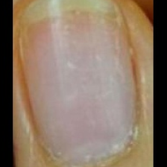
True: healthy, Predicted: other
The misclassification appears to be due to low-level visual features such as mild discoloration, uneven lighting, or texture variations

Slide 8
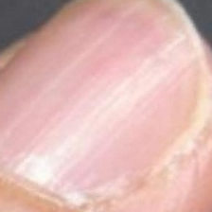
True: healthy, Predicted: melanoma
This healthy sample was misclassified as melanoma, likely due to subtle linear discoloration

Slide 9
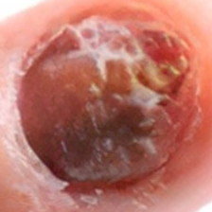
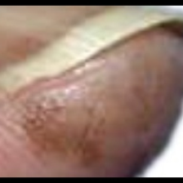
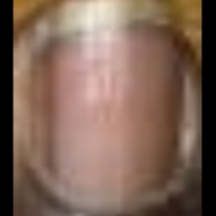
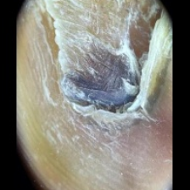
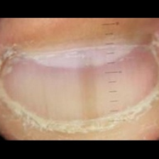
True: melanoma, Predicted: other
The misclassification is mainly due to overlapping visual features between melanoma and other nail diseases, such as irregular texture or non-uniform pigmentation, which can reduce class separability.

Slide 10
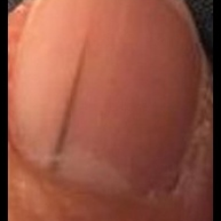
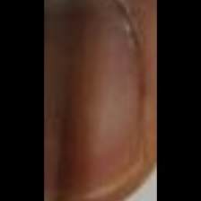
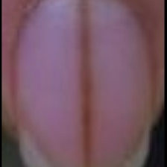
True: melanoma, Predicted: healthy
These melanoma samples were misclassified as healthy due to very subtle or low-contrast pigmentation and minimal visible irregularities. The lack of clear pigmentation reduced the model’s ability to separate these cases from normal nail appearances

Slide 11
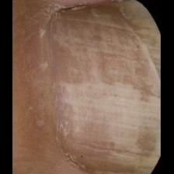
True: other, Predicted: melanoma
This sample belongs to the other class but was predicted as melanoma, likely due to irregular color patterns

Slide 12
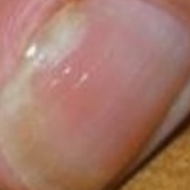
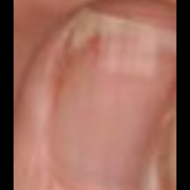
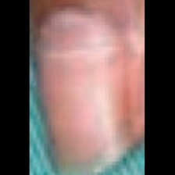
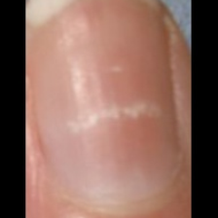
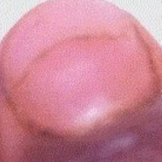
True: other, Predicted: healthy
These samples belong to the other class but were predicted as healthy, likely because the pathological features are mild or visually subtle

Slide 13

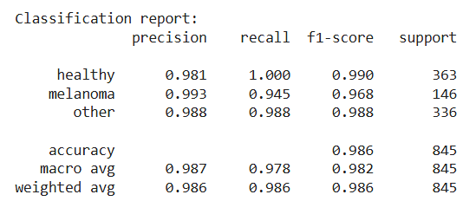
Misclassified samples from YOLO
epochs: 10, batch size: 32, lr0: 1e-3 (one of the best performing configurations)

Slide 14
YOLOv8
True Class | Predicted: healthy | Predicted: melanoma | Predicted: other | Total
Healthy | 363 (correct) | 0 | 0 | 363
Melanoma | 4 (false) | 138 (correct) | 4 (false) | 146
Other | 3 (false) | 1 (false) | 332 (correct) | 336
Healthy: 363/363
Melanoma: 8/146
Other: 4/336
Total: 12 errors

Slide 15
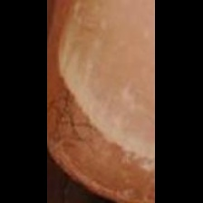
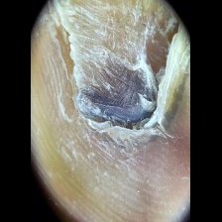
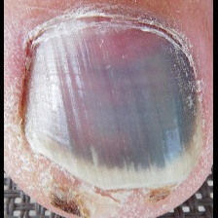
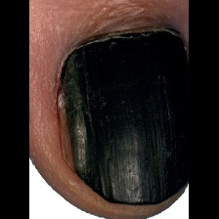
True: melanoma, Predicted: other
These melanoma samples were misclassified as other due to visual overlap with non-melanoma nail disorders

Slide 16
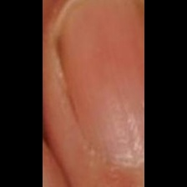
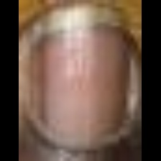
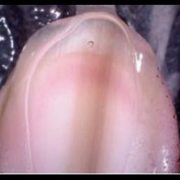
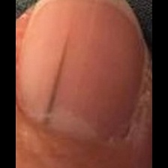
True: melanoma, Predicted: healthy
These melanoma samples were misclassified as healthy due to very subtle pigmentation or near-normal nail appearance.

Slide 17
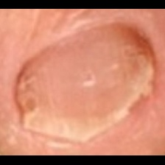
True: other, Predicted: melanoma
This sample belongs to the other class but was predicted as melanoma, likely due to subtle color variations

Slide 18
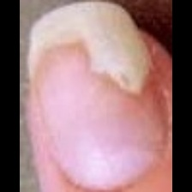
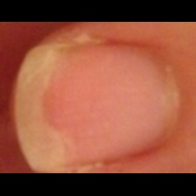
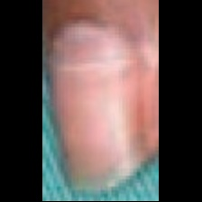
True: other, Predicted: healthy
These samples belong to the other class but were predicted as healthy due to their near-normal visual appearance and the absence of strong pathological features.

Slide 19
Samples, which are misclassified by both models
true: melanoma,
ViT, YOLO: other
true: melanoma,
ViT: other, YOLO: healthy
true: other,
ViT, YOLO: healthy
true: melanoma,
ViT, YOLO: healthy

Slide 20
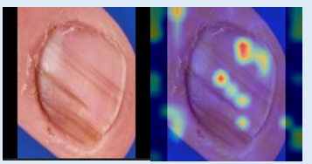
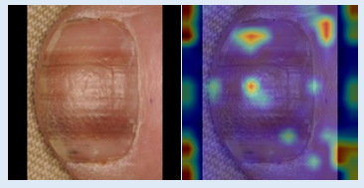
Step 8 (optional). Integration of Explainable AI
Explainable AI (XAI) helps the user understand why the AI made a certain decision. In our case, instead of just giving a prediction, the model shows which parts of the nail influenced that decision.
Heatmaps highlight the regions, which the model focused on → important for the explainability.

Slide 21
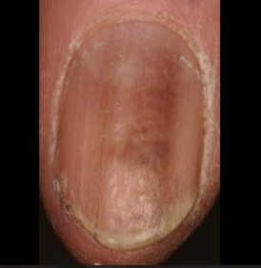
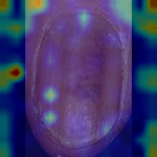
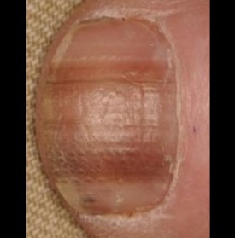
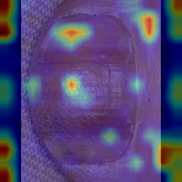
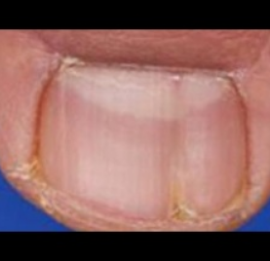
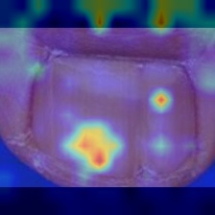
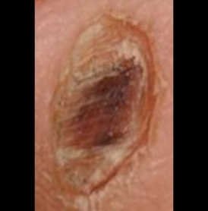
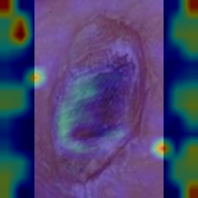
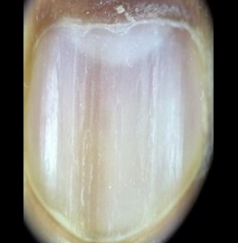
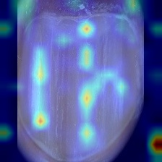
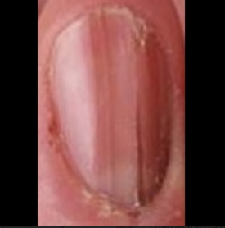







XAI: heatmaps from ViT-B/16

Slide 22









XAI: Heatmaps from YOLOv8

Slide 23


Comparison
The ViT-B/16 heatmaps are more diffuse and distributed across the entire nail, highlighting multiple areas. This shows that the model captures global information and long-range dependencies rather than focusing on a single localized region.
In contrast, the YOLOv8 heatmaps show more localized patterns, mostly focusing on visually salient regions of the nail such as pigmentations, lesions, or irregular structures.
Overall, both models focus on clinically relevant nail regions, but they differ in their attention strategies

Slide 24
XAI: heatmaps from ViT-B/16

Slide 25
XAI: Heatmaps from YOLOv8

Slide 26


Slide 27


Slide 28


Slide 29


